Slide 1
Evolving Service Costs Amortization
Steve Lasker
Program Manager
Azure Developer Experiences
blogs.msdn.microsoft.com/SteveLasker
@SteveLasker
Steve.Lasker@Microsoft.com

Slide 2
Amortizing Costs An evolution, revolution, or circle of service?

Slide 3
– Mainframes
CIRCA 1980

Slide 4
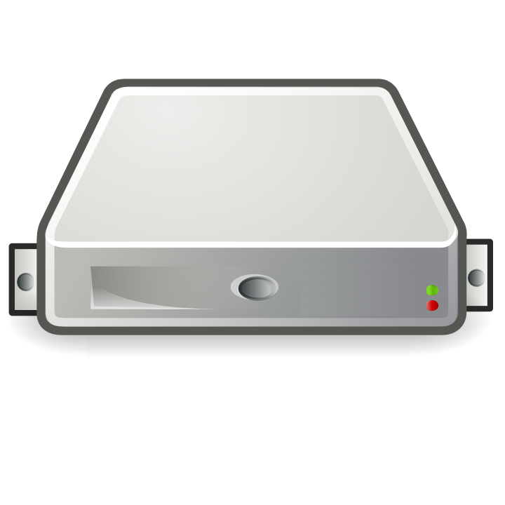
– PC → Server Revolution
CIRCA 1990
$
$
$
$
$
$
$
$
$
$
$
$
$
$
$
$
$
$
$
$
$
$
$
$
$
$
$
$
$
$
$
$
$
$
$
$
$
$
$
$
$
$
$
$
$
$
$
$
$
$
$
$
$
$
$

Slide 5
– Server → VM Evolution
CIRCA 2000
Guest OS #5
Guest OS #6
Guest OS #7
Guest OS #8
Guest OS #5
Guest OS #6
Guest OS #7
Guest OS #8
Guest OS #5
Guest OS #6
Guest OS #7
Guest OS #8
Guest OS #5
Guest OS #6
Guest OS #7
Guest OS #8
Guest OS #5
Guest OS #6
Guest OS #7
Guest OS #8
Guest OS #1
Guest OS #2
Guest OS #3
Guest OS #4
Guest OS #1
Guest OS #2
Guest OS #3
Guest OS #4
Guest OS #1
Guest OS #2
Guest OS #3
Guest OS #4
Guest OS #1
Guest OS #2
Guest OS #3
Guest OS #4
Guest OS #1
Guest OS #2
Guest OS #3
Guest OS #4
Hyper Visor
Hyper Visor
Hyper Visor
Hyper Visor
Hyper Visor
$
$
$
$
$

Slide 6
– VM → Cloud Evolvement
CIRCA 2015
Guest OS #5
Guest OS #6
Guest OS #7
Guest OS #8
Guest OS #5
Guest OS #6
Guest OS #7
Guest OS #8
Guest OS #5
Guest OS #6
Guest OS #7
Guest OS #8
Guest OS #5
Guest OS #6
Guest OS #7
Guest OS #8
Guest OS #5
Guest OS #6
Guest OS #7
Guest OS #8
$
$
$
$
$
$
$
$
$
$
$
$
$
$
$
$
$
$
$
$
Guest OS #1
Guest OS #2
Guest OS #3
Guest OS #4
Guest OS #1
Guest OS #2
Guest OS #3
Guest OS #4
Guest OS #1
Guest OS #2
Guest OS #3
Guest OS #4
Guest OS #1
Guest OS #2
Guest OS #3
Guest OS #4
Guest OS #1
Guest OS #2
Guest OS #3
Guest OS #4
$
$
$
$
$
$
$
$
$
$
$
$
$
$
$
$
$
$
$
$
Hyper Visor
Hyper Visor
Hyper Visor
Hyper Visor
Hyper Visor

Slide 7
Distributed, Scalable Mainframe
– Cloud → Containerization
CIRCA 2015
Guest OS #2
Guest OS #2
Guest OS #2
Guest OS #2
Guest OS #2
$
$
$
$
$
Guest OS #1
Guest OS #2
Guest OS #3
Guest OS #4
Guest OS #1
Guest OS #2
Guest OS #3
Guest OS #4
Guest OS #1
Guest OS #2
Guest OS #3
Guest OS #4
Guest OS #1
Guest OS #2
Guest OS #3
Guest OS #4
Guest OS #1
Guest OS #2
Guest OS #3
Guest OS #4
$
$
$
$
$
Hyper Visor
Hyper Visor
Hyper Visor
Hyper Visor
Hyper Visor

Slide 8

Docker Containers and VMs
Host OS - Hardware
Hyper Visor
Guest OS #1 (Virtual Machine)
Guest OS #2 (Virtual Machine)
Guest OS #3
Docker Daemon

Slide 9
App A
App A’
App B
Containers are isolated, but share OS and, where appropriate, bins/libraries
Bins/Libs
Bins/Libs
Bins/Libs
Guest OS
Guest OS
Guest OS
App A
App A’
App B
App B’
App B
App B’
App B
App B’
Bins/Libs
Bins/Libs
Hypervisor
Docker Engine
Host OS
Host OS
Server
Server

Slide 10
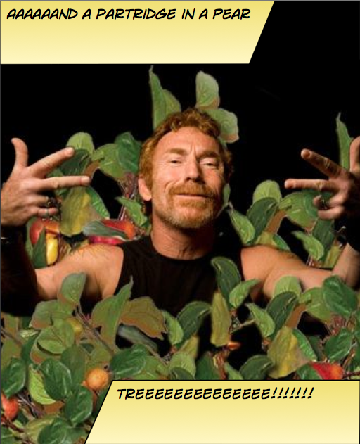
Instancing Multiple Copies
You need:
10 web front ends
8 API instances
4 Redis Cache
1 Database

Slide 11

Web
Web
Web
Web
Web
API
API
API
Cache
Cache

Slide 12

Load Balancing & Fault Tolerance
DOCKER_HOST
Docker daemon
Containers
Image Cache
Web
Web
Web
Web
Web
Web
API
Cache
API
API
API
Cache
Cache

Slide 13


Distribution
DOCKER_HOST
DOCKER_HOST
Docker daemon
Docker daemon
Containers
Image Cache
Containers
Image Cache
Container Scheduling
Container Orchestration
DOCKER_HOST
DOCKER_HOST
DOCKER_HOST
DOCKER_HOST
Docker daemon
Docker daemon
Docker daemon
Docker daemon
Containers
Image Cache
Containers
Image Cache
Containers
Image Cache
Containers
Image Cache
Web
Web
Web
Web
Web
Web
Cache
API
Cache
Web
Web
API
Cache
API
Cache
API
API
API
Cache
Cache

Slide 14



Container Workflow
Test
SCC
Container Registry
Docker-compose
Test.env
CI
Docker-compose.yml
Base Image
Staging
Dockerfile
Build
Docker-compose
Push
Compiled Code
Integration
Client
Stag.env
Int.env
Write/Edit
Docker build
Production
Debug
Docker-compose up
Docker-compose
Docker push
Tests
Run
Prod.env
Local Development Environment

Slide 15
Container Workflow
Test
Scheduling
Orchestration
Registry
SCC
Environment
CD
Staging
Integration
Write/Edit
Production
Debug
CI/Build Environment
Tests
Run
Local Development Environment

Slide 16











public registry
VM Scale Sets
Azure Container Service
Azure Hosted Docker Private Registry
.NET Core
Test
Visual Studio Team Services
Azure Container Registry
Source Code Control
Build
Continuous Integration
3rd Party Integration:
Azure Container Service
Staging
VSTS Build Agents w/ Docker
Orchestration & Scheduling - Marathon / Docker Swarm
Visual Studio
Integration
ASP.NET
In Container Development
Edit & Refresh
Breakpoint Debugging
Production
Debug
Write/Edit
Run
Visual Studio Code
Docker Language Services
Docker Scaffolding w/yo docker

Slide 17
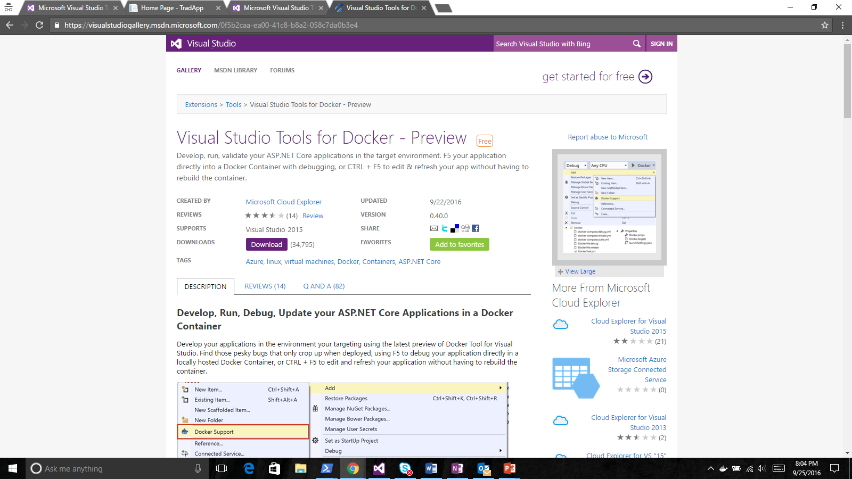
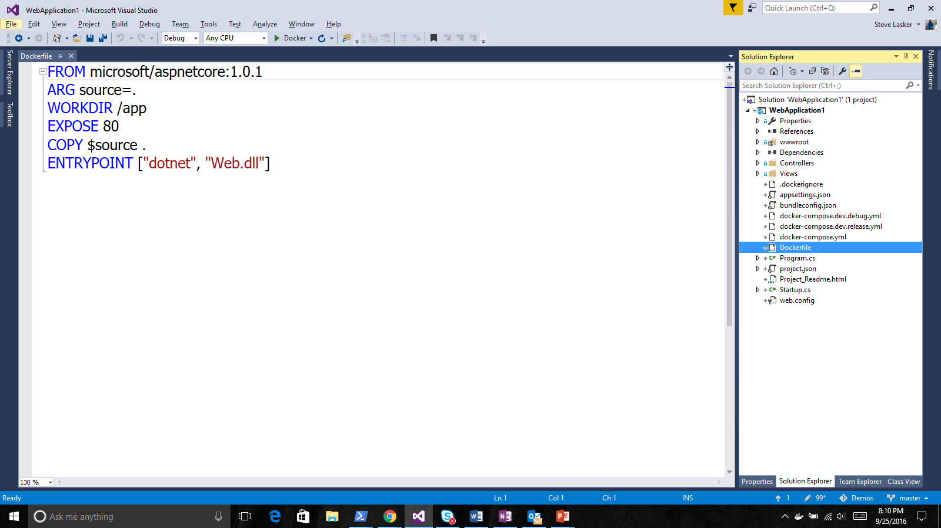
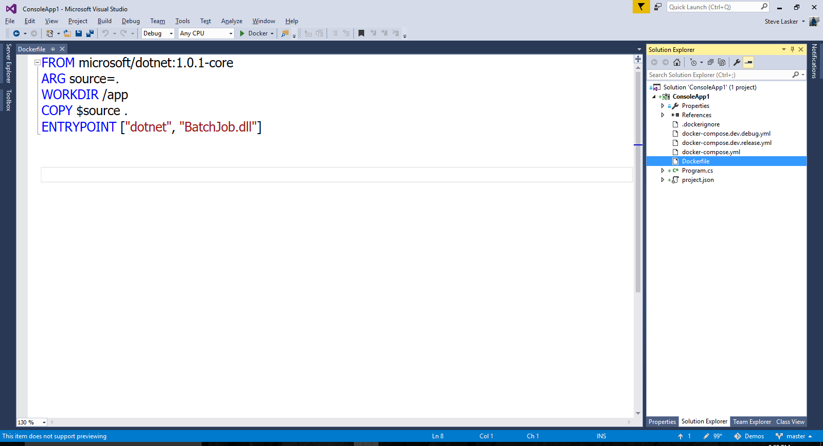
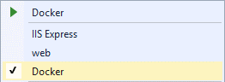
Visual Studio Docker Tools
Run, Debug, Test Web & Console apps in docker containers
Linux today, Windows Server & Nano Server coming soon
F5 Debugging
Edit & Refresh of code
Scaffolds docker assets
Dockerfile, docker-compose.yml
aka.ms/DockerToolsForVS

Slide 18
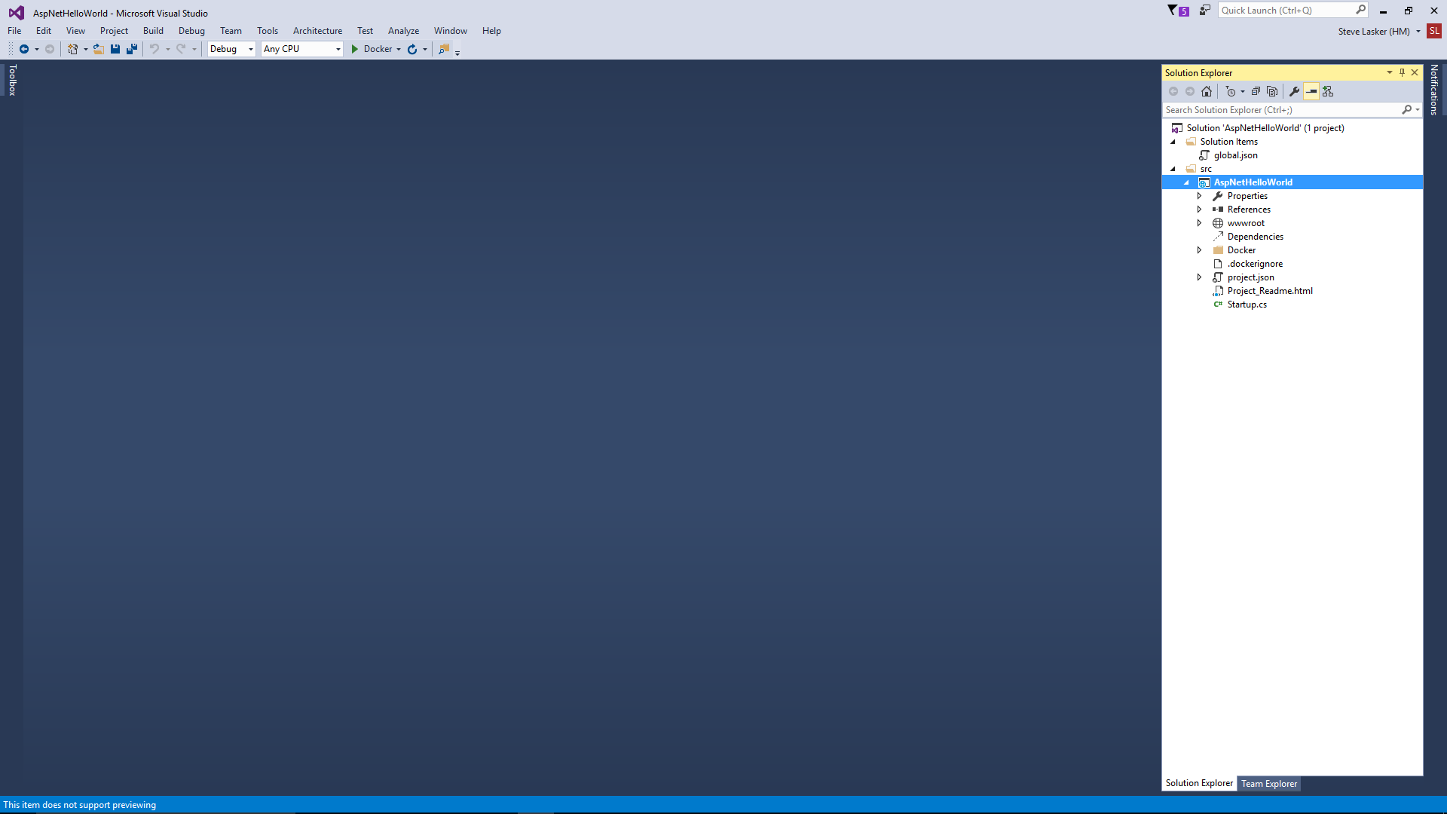
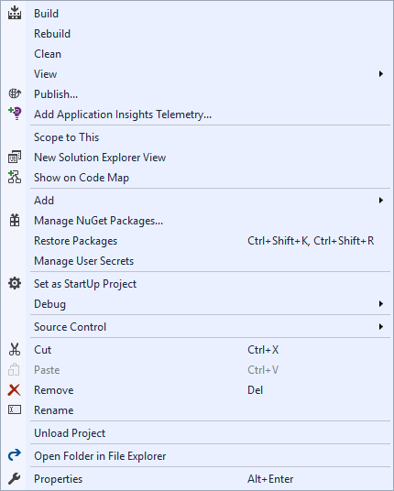
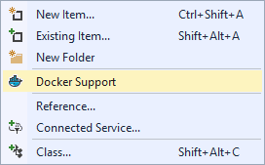
Docker Tools for Visual Studio

Slide 19

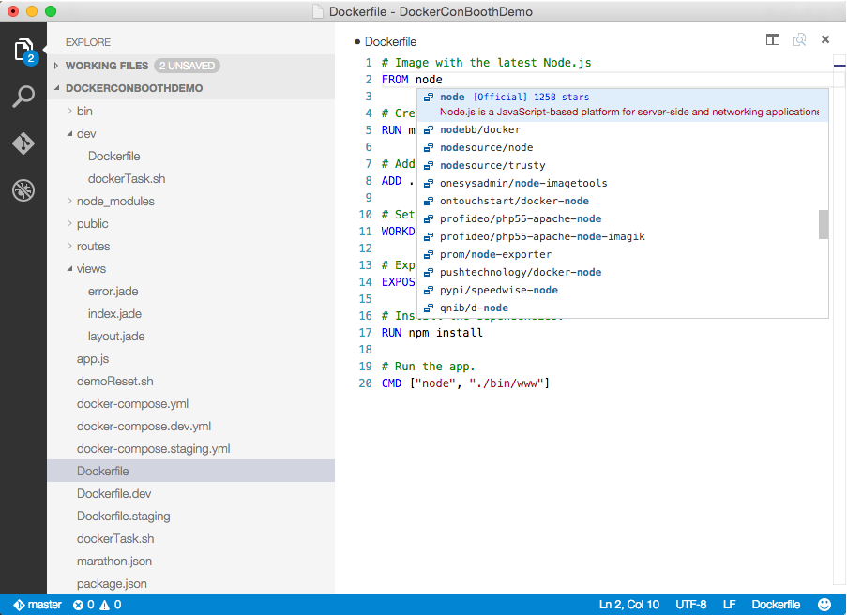
Visual Studio Code
OS X, Linux, Windows
Lightweight, keyboard focused
IntelliSense, GoTo Def, refactoring
Git SCC integration
Extensible platform
Docker Asset Editing - extension
aka.ms/VSCode
aka.ms/DockerToolsForVSCode

Slide 20
Container OS Targeting
Docker Containers == Single Processes
Multiple Websites/Services = multiple containers
…microservices
Target the optimized OS for the service/framework

Slide 21
.NET OS Targeting w/Containers
.NET Framework
3.5-4.6
Windows Server Core
Compatible with existing apps
Larger Image
.NET Core
Nano Server
Cloud Optimized, Container OS
Smaller, Faster Start Times
Linux
Linux Distros

